Slide 1
Automated data versioning
Peter Benjamin Volk ^{* +}, Guillaume Delannoy *
*DDEngine.org
⁺Technische Universität Dresden
Database Technology Group

Slide 2
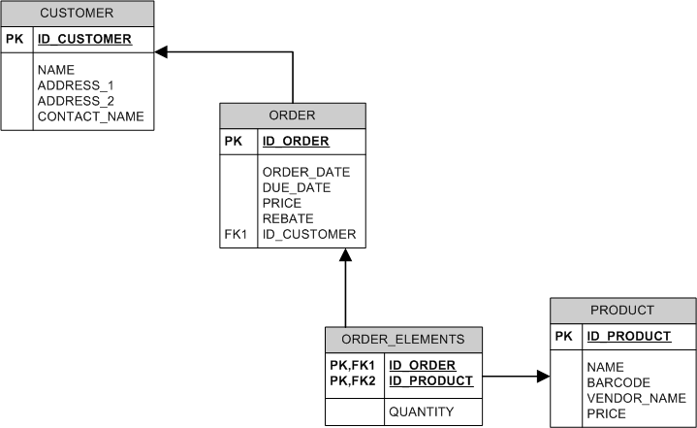
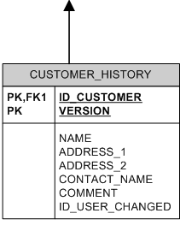
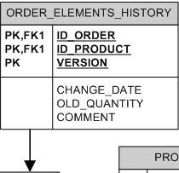
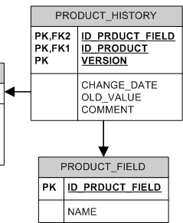
A typical OLTP application

Slide 3
Requirements
Generic method for all DML statements on Table
Versioning with low overhead for DML
Schema optimal for workload and storage requirements
Versioned data accessible via SELECT statements
Low maintenance
No “own” storage engine

Slide 4
Data auditing
Stakeholders
  Required for data security
  Legal regulations
  Internal provisioning
Real world example
  1200 Tables
  43% tables for versioning tables
  Code for versioning most complicated in application and least maintained
  Low TX volume on versioning tables

Slide 5
Data auditing
Multiple table versioning schemas
Implementation via
  Triggers on tables
    High maintenance
  Logic in application layer
    Multiple applications on same DB
    Complicated code
  Query log extraction
    High storage effort
    Roll forward only
  WL#2878 (Simple data auditing)
    MySQL 7.0 (maybe)

Slide 6
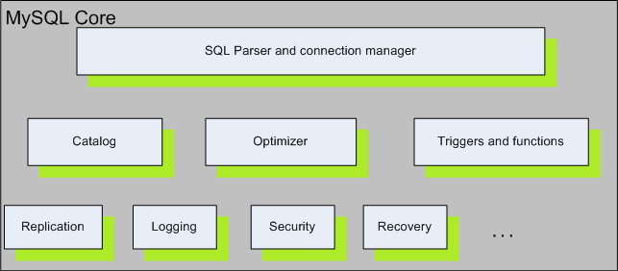
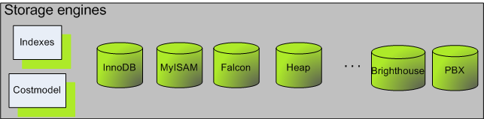
Architecture

Slide 7
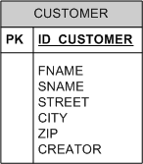
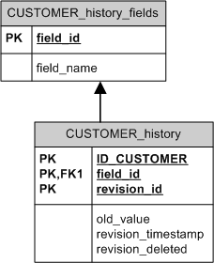
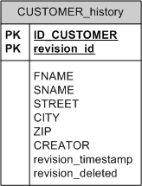
Versioning schemas (I)
SINGLE
DOUBLE

Slide 8
Table creation
Revision engine as “normal” storage engine
create table CUSTOMER (
ID_CUSTOMER int not null primary key,
FNAME char(20),
SNAME char(20),
STREET char(50),
CITY char(50),
ZIP int(10),
CREATOR char(50)
) engine=revision comment="InnoDB:SINGLE";

Slide 9
Insert, Update, Delete
Insert
  Insertion into base table
Update
  Marking of change properties in data set
  Insertion old values into history table
  Update on base table
Delete
  Insertion of row into history table
  Mark row as deleted in history table
  Delete on base table
Versioning
  Version ID is autoincrement per row
  No DML statements at all on versioning tables

Slide 10

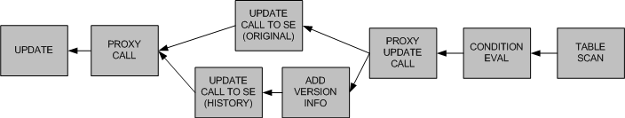
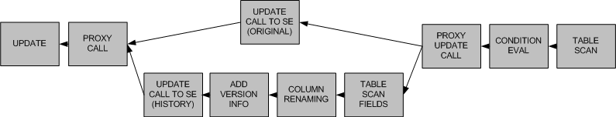
Query expansion (Update)
Original
SINGLE
DOUBLE

Slide 11
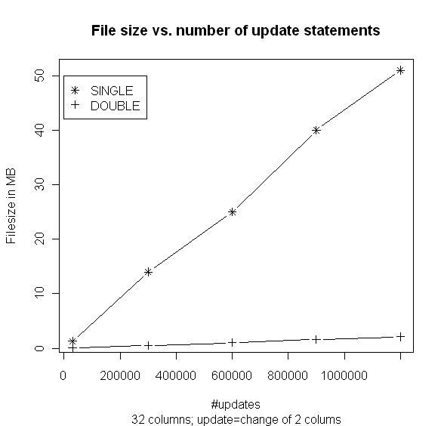
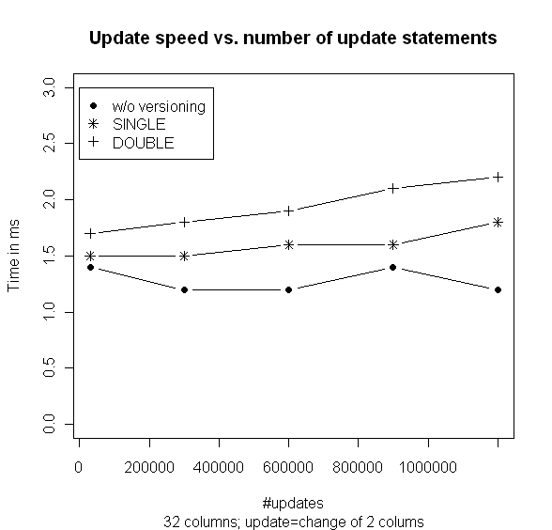
Evaluation (I)

Slide 12
Data retrieval
Data Version selectable via session variable (revision_select_mode)
  current (default)
  history → All historic data
  deleted → All deleted data sets
  time → Data set to a specific time
Extended Selection (revision_select_asof, revision_select_mode)
  time → specifies the exact point of time of the version

Slide 13
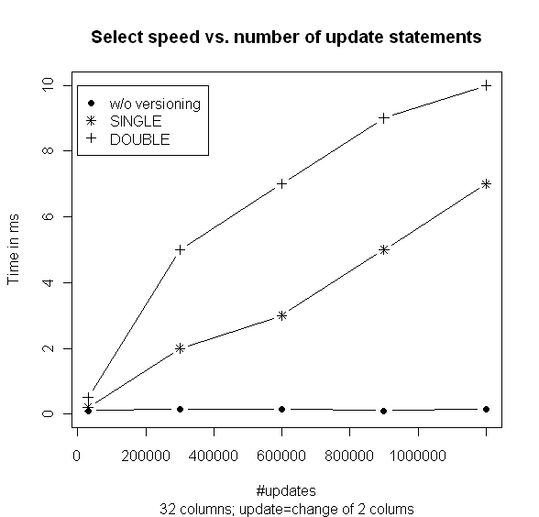
Evaluation (II)

Slide 14
Versioning schemas (II)

Slide 15
Table creation (II)
Revision engine as “normal” storage engine
create table CUSTOMER (
ID_CUSTOMER int not null primary key,
FNAME char(20),
SNAME char(20),
STREET char(50),
CITY char(50),
ZIP int(10),
CREATOR char(50)
) engine=revision comment="InnoDB,Archive:DOUBLE";

Slide 16
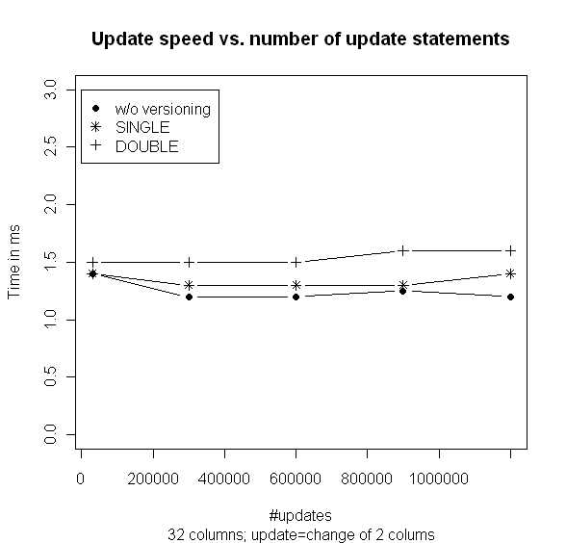
Evaluation (III)

Slide 17
Automatic table type selection
engine=revision comment="InnoDB,AUTO:DOUBLE";
Versioning tables rarely selected
Tradeoff between select/insert performance and disk consumption
If Versioning tables selected then for long time period → automated table transformation

Slide 18
Tradeoff
Permanent transformation between versioning table types expensive (drop old table, create new table, insert data)
Transformations for single select-TX or transaction sequence
If session performs select-TX on history data create shadow table with session specific data

Slide 19
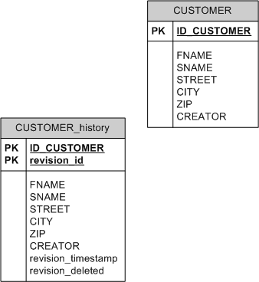
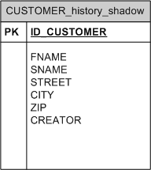
Shadow table
revision_select_mode = version
revision_select_asof = 9
SELECT……
InnoDB
Archive
InnoDB

Slide 20
Challenges
“Auto” is optimal for insert and update performance via archive engine
Costs for table transformation once per session
Shadow table share between sessions?
How many selects before shadow is created?
Temporarily permanent shadow tables?
Incremental shadow tables?

Slide 21
Status
V0.1 – Alpha released Sep ’08
  Basic versioning
  Homogenous storage engines
  Multiple versioning schemas
V0.2 – Beta release ’09
  Bugfixes (thanks Giuseppe)
  Hybrid storage engines
  Insertion into history table as “admin”
  Column fine versioning
VX
  Intermediate optimizer for history tables (table scan vs. index)
  Temporary indexes for shadow tables
  Automated schema selection
  As of syntax for select modes
  Automated storage engine selection

Slide 22
Conclusion
Transparent versioning for table data
Usage of existing SE as base table
Storage of data versions with different schemas
Disk optimal and SELECT optimal schemas
Transformation of history tables into shadow tables for fast ASOF syntax

Slide 23
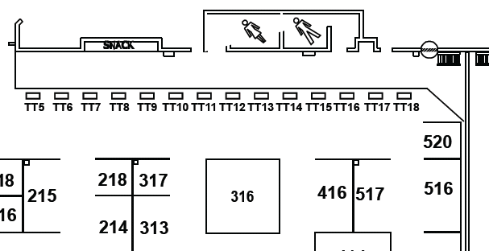
Thanks to
Guillaume Delannoy
Wolfgang Lehner (Technische Universität Dresden)
Dot org booth
Tuesday and Wednesday
Booth 14

Slide 24
Automated data versioning
Peter Benjamin Volk ^{* +}, Guillaume Delannoy *
*DDEngine.org
⁺Technische Universität Dresden
Database Technology Group

